Slide 1
Capstone Project (DAP)
A PowerBI Dashboard

Slide 2
Content
Introduction
Data Cleaning
Data Visualization (PowerBI)
Data Insights
Conclusion

Slide 3
Introduction
An organization's or a group's key metrics can be kept on a dashboard, which is a consolidated platform.
When done effectively, it can serve as a company's main information source. Dashboards are useful for tracking an organization's performance and boosting productivity.
This project presents a getInnotized analytical dashboard solution. The dashboard provides streamlined data that may affect decision-making in the future for the organization's growth.

Slide 4
Data Cleaning
Some data modification performed are;
Handling NAN values
Date Corrections
Deleting Blank rows
Correcting dataypes
Merging sheets from different sources into one dataframe
Data cleaning is the process of detecting and correcting inaccurate records in your dataset
In this project, the data was cleaned with both python and excel powerquery

Slide 5
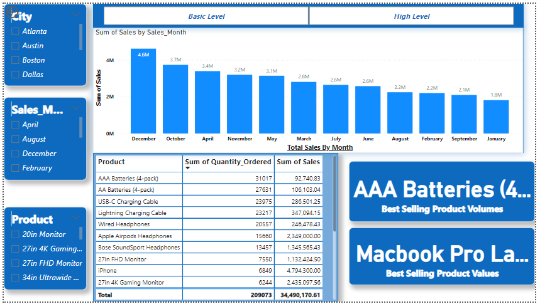
Dashboard Presentation

Slide 6
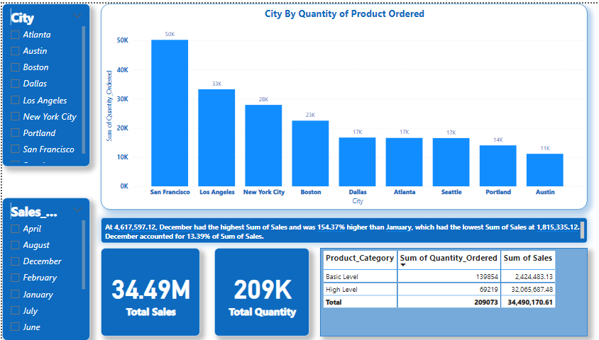
Dashboard Presentation

Slide 7
Data Insights
The client made a total of 34.5M in the year 2019
Sales increased from Jan. to April, decreased from May to Sep., and then increased from Oct. to Dec. Thus, sales increases in the first four months and the last three months.

Slide 8
Data Insights (cont’d)
Best-Selling Products
Macbook Pro Laptop
iPhone,
Thinkpad Laptop
Google Phone
27in 4K Gamming Monitor
34in Ultrawide Monitor
Apple Airpods Headphones,
FlatScreen TV, Bose SoundSport Headphones, 27in FHD Monitor
Worst-Selling Products
20in Monitor
27in FHD Monitor
AA Batteries (4-pack)
AAA Batteries (4-pack)
LG Dryer,
LG Washing Machine
USB-C Charging cable,
Wired Headphones
Lighting Charging cable
Vareebadd Phone

Slide 9
Data Insights (cont’d)
Cities with the most product deliveries are San Francesco, followed by Los Angeles, New York City, and Boston
High-level products generated a revenue of $32.1M with quantity of 15.7K sold while basic-level products generated a revenue of $2.4M with quantity of 15.3K sold
Thursdays recorded the highest sales in the 2019, followed by Saturdays, Tuesdays, Fridays, Mondays and Wednesdays with Sundays recording the lowest sales.

Slide 10
Conclusion
Good visualized data presentation makes an organization effective and is also instrumental in decision making.

Slide 11

Thank You
Team Autumn
Group Members
Winifred Kwakye
Evans Tetteh Akoto
Lihla Saisi Shiribwa
Anne Njeri Kamau

